Slide 1

Students Mobility: STORK Project Deployment
Paúl Santapau Nebot
Vicente Andreu Navarro

Slide 2

STORK large scale pilot
eGovernment objectives (ICT-PSP call 2007)
Type A
eProcurement
eHealth
Type B
Thematic
Networks
eParticipation
Impact & user satisfaction
eID interoperability
Electronic documents
Accessible & inclusive eGovernment
Combined delivery of social services
Brokering pan-EU eGov solutions & services online

Slide 3

STORK large scale pilot
Vision:
To simplify administrative formalities by providing secure online access to public services across EU borders.
Mission:
To develop and test common specifications for secure and mutual recognition of national electronic identity (eID) between participating countries.

Slide 4
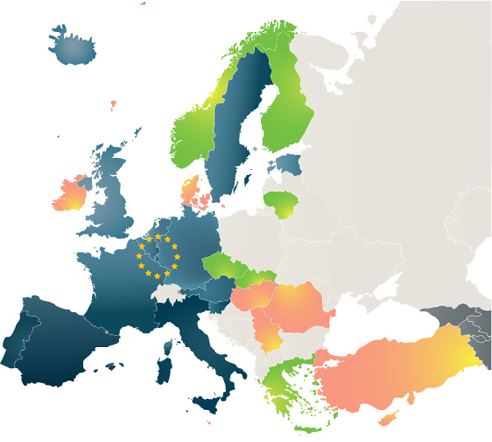
STORK – Member State involvement
14 Member States- STORK I
4 additional MS – STORK II
Member States Ref Group

Slide 5






STORK Pilot 3 – eID Student Mobility
Objective:
“The main goal of the Student Mobility pilot is to demonstrate that STORK infrastructure can be used for developing cross-border electronic services in the academic environment and for facilitating student’s mobility across Europe.”
How?
  By allowing the students to use their own national credentials when accessing electronic services offered by a foreign University.
Notes:
5

Slide 6
STORK Pilot 3 – eID Student Mobility
Participants
    CRUE SPAIN (Universitat Jaume I, as coordinator, and seven more Spanish Universities)
    Ministerio de Presidencia SPAIN
    Instituto Superior Técnico PORTUGAL
    Politecnico di Torino ITALY
    Technische Universität Graz AUSTRIA
    AS Sertifitseerimiskeskus ESTONIA (provides registration services for University of Tallinn, Technical University of Tallinn and University of Tartu).

Slide 7
STORK Pilot 3 – eID Student Mobility
Use cases:
Students’ mobility pilot focuses on two interoperability use-cases:
  Use Case 1: Foreign students with valid STORK credentials are allowed to register as Erasmus students in the Universities involved in the pilot.
  Use-Case 2: Foreign students (or candidate students) with valid STORK credentials are granted access, through single-sign-on mechanisms, to different academic services offered by the Universities taking part in the pilot.

Slide 8
STORK Pilot 3 – eID Student Mobility
 | ES-UJI | PT-IST | AT-TUG | IT-POLITO | EE-SAIS
UC1: Erasmus enrolment / pre-enrolment | YES | YES | YES | YES | YES
UC2: Foreign students / citizens register to specific courses | YES | YES |  | YES | YES
UC2: Access to other on-line services through SSO | YES | YES | YES | YES
 | Obtention of additional credentials Access to on-line resources | Obtention of additional credentials Access to on-line resources | Access to on-line resources | Access to online resources (e.g. Access to Digital Library Resources: for students, researchers and visitors.)

Slide 9

STORK Pilot 3 – eID Student Mobility
Current situation:
  The pilot has started to run partially:
  Identity providers
    PT, AT already running
    ES, IT, EE scheduled for the end of June
  Service providers (all ready, but depending on the MS and the Erasmus registration period)
    AT-TUG, running UC2
    PT-IST, running UC1 and UC2
    EE-SAIS
    IT-POLITO
    ES-UJI
Notes:
9

Slide 10
STORK Pilot 3 – eID Student Mobility
Conceptual model:
  Three main elements:
    SP service providers
    IdP identity providers
    PEPS Pan-european Proxy server
Notes:
10

Slide 11





STORK Pilot 3 – eID Student Mobility
Pan-European eIDM Model
PEPS
PEPS
PEPS
PEPS
PEPS
Notes:
11

Slide 12
STORK Pilot 3 – eID Student Mobility
Pan-European eIDM Model
IDP/VIDP
PEPS
PEPS
PEPS
IDP/VIDP
PEPS
PEPS
IDP/VIDP
IDP/VIDP
IDP/VIDP
Politecnico di Torino
Notes:
12

Slide 13
STORK Pilot 3 – eID Student Mobility
Pan-European eIDM Model
SP
Universitat Jaume I
SP
Universitat Rovira i Virgili
IDP/VIDP
SP
..
.
PEPS
IST
SP
PEPS
PEPS
Universidad de Alicante
Tallinn University of Technology
IDP/VIDP
SP
PEPS
Tallinn University
SAIS
PEPS
University of Tartu
IDP/VIDP
SP
SP
TU Graz
IDP/VIDP
Politecnico di Torino
Notes:
13

Slide 14







STORK Pilot 3 – eID Student Mobility
Pan-European eIDM Model
SP
Universitat Jaume I
SP
Universitat Rovira i Virgili
IDP/VIDP
SP
..
.
PEPS
IST
SP
PEPS
PEPS
Universidad de Alicante
Tallinn University of Technology
IDP/VIDP
SP
PEPS
Tallinn University
SAIS
PEPS
University of Tartu
IDP/VIDP
SP
SP
Belgium
Iceland
Germany
Luxemburg
Sweden
Slovenia
TU Graz
IDP/VIDP
IDP/VIDP
Politecnico di Torino
Notes:
14

Slide 15




STORK Pilot 3 – eID Student Mobility
Pan-European eIDM Model
SP
Universitat Jaume I
SP
Universitat Rovira i Virgili
IDP/VIDP
SP
..
.
PEPS
IST
SP
PEPS
PEPS
Universidad de Alicante
Tallinn University of Technology
IDP/VIDP
SP
PEPS
Tallinn University
SAIS
PEPS
University of Tartu
IDP/VIDP
SP
SP
TU Graz
IDP/VIDP
IDP/VIDP
Politecnico di Torino
Notes:
15

Slide 16

The process.
Estonian user wants to enroll in a TU-Graz course:
What’s happening?
  On TU-Graz Web Site:
    User connect to the apply Web Site.
    He or She get redirected to the STORK to get an identity proof.
    When back, He or She is authenticated with some attributes associated.
  On the STORK infrastructure:
    The Source PEPS, redirects the user to the correct Colleague PEPS.
    The Colleague PEPS knows who is the correct IDP, it redirects the user to it.
  On the identity provider:
    Ask for a clear and informed consent on attributes to be exchanged.
    Authenticates the user and redirect him or her back with the identity proof.

Slide 17
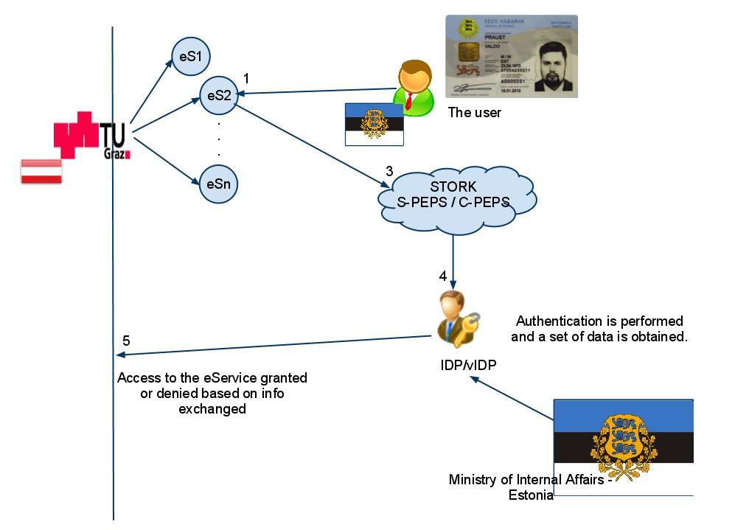
The process.

Slide 18
A different case.
Italian user wants to enroll in a UJI course:
Particularities:
  Spanish RedIRIS SIR.
    There is a common entry point for identity federation among universities in Spain managed by RedIRIS. It hides the real backend offering an easy to integrate connector.
  Politecnico di Torino act as a IdP.
    The University plays the role of identity provider..

Slide 19
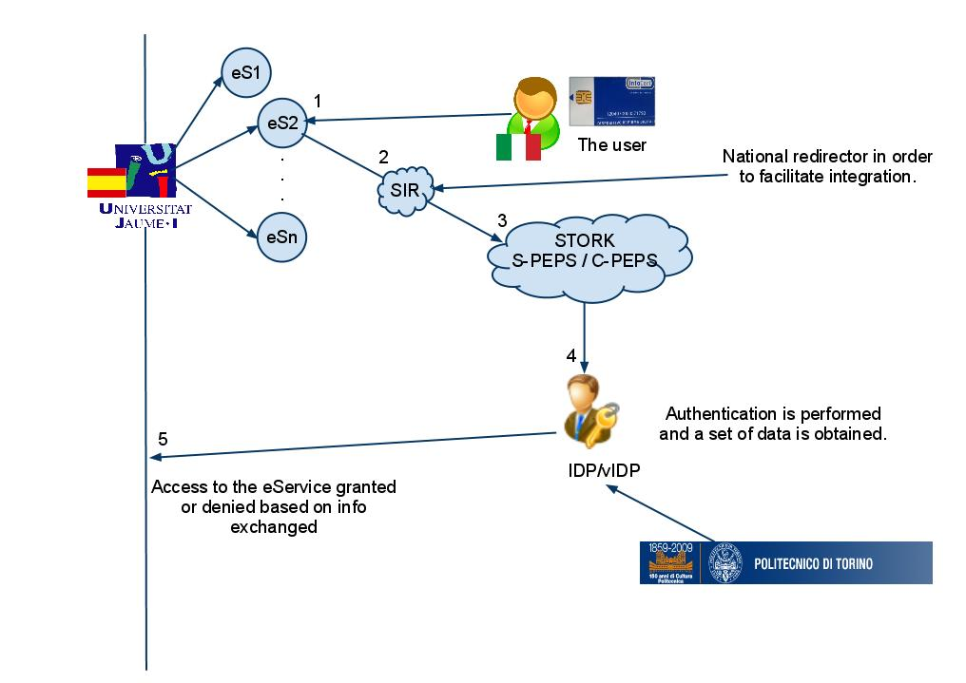
The process.

Slide 20
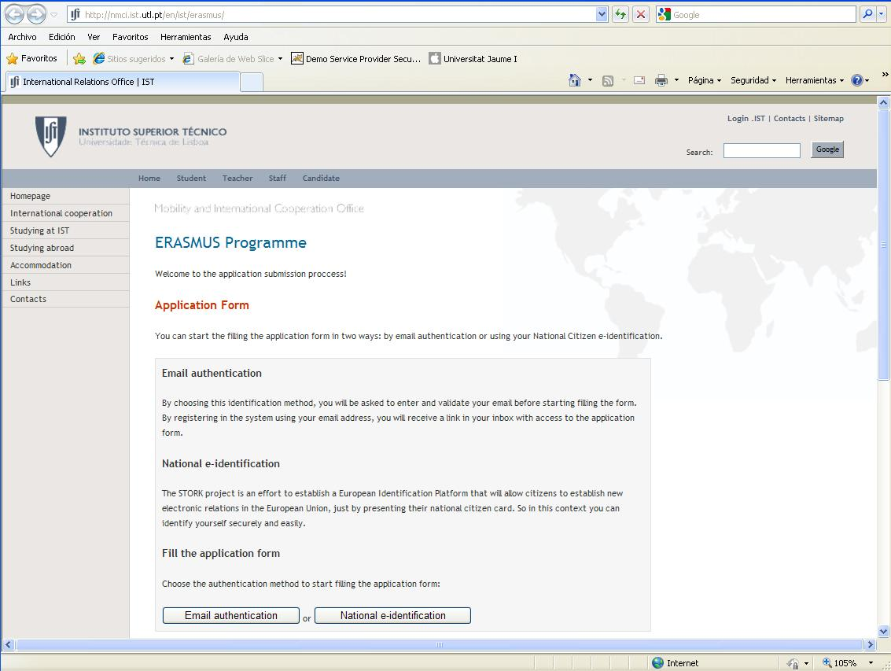

Slide 21
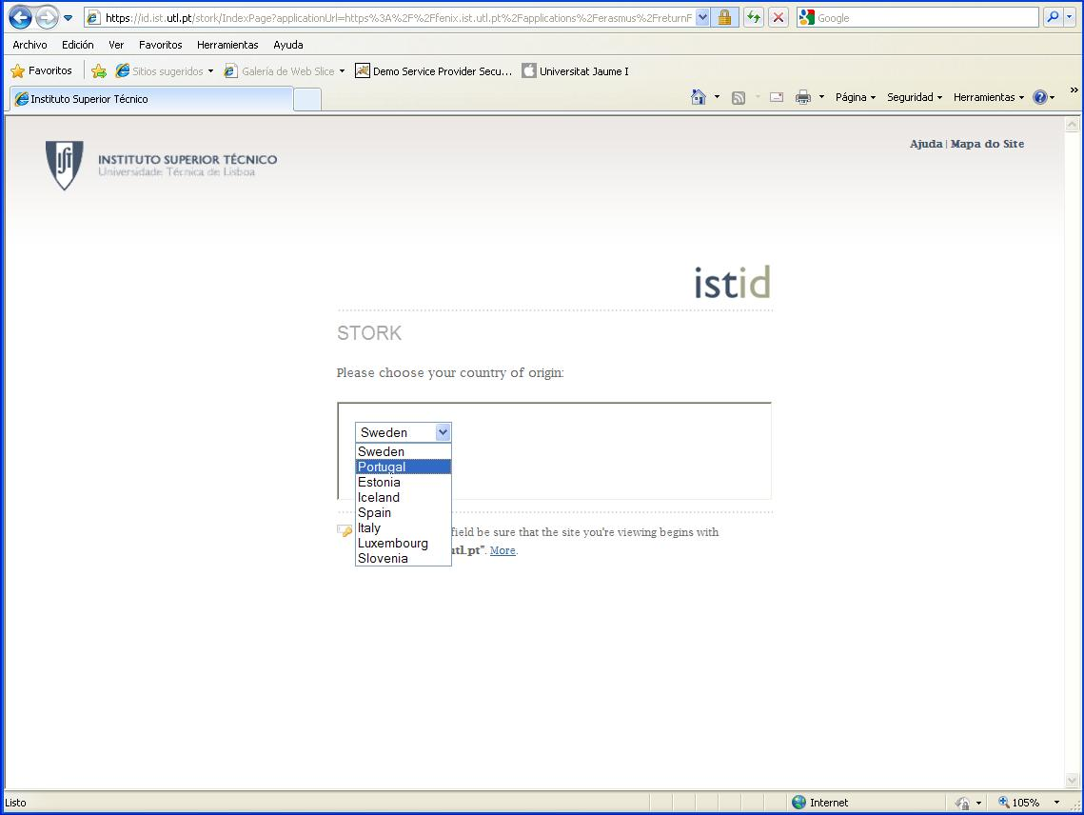

Slide 22
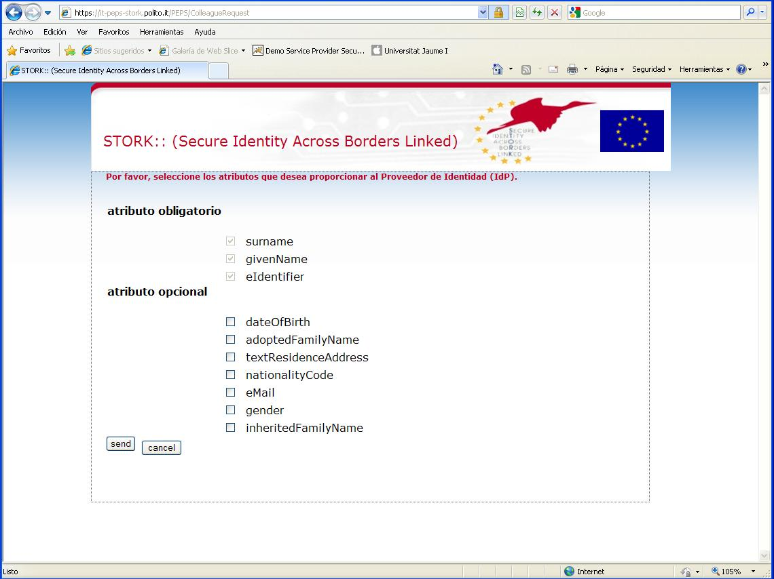

Slide 23
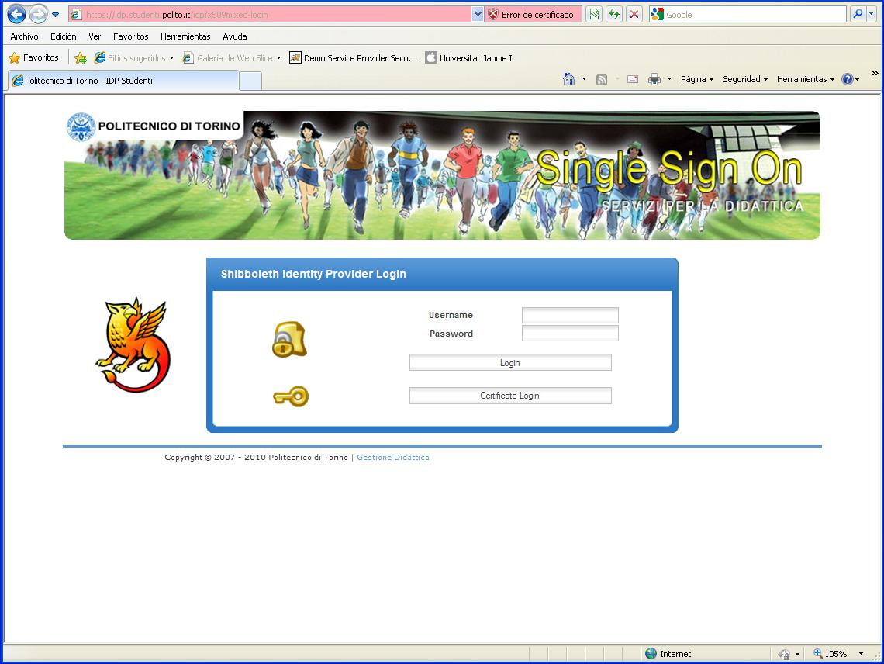

Slide 24
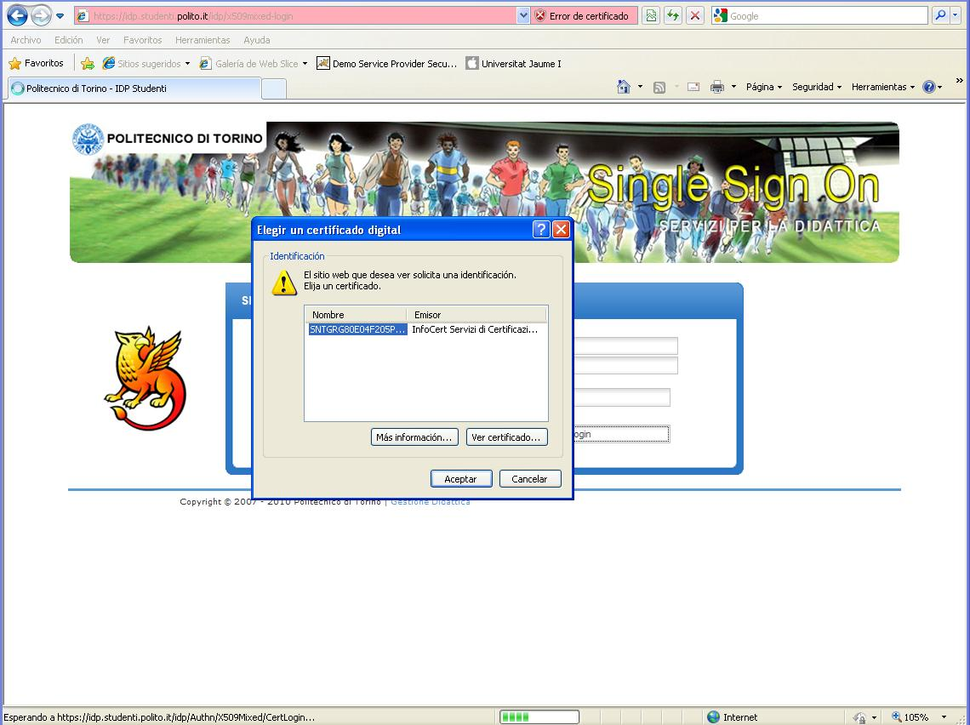

Slide 25
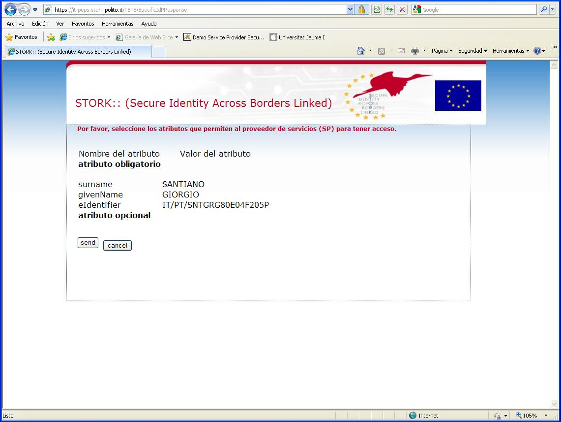

Slide 26
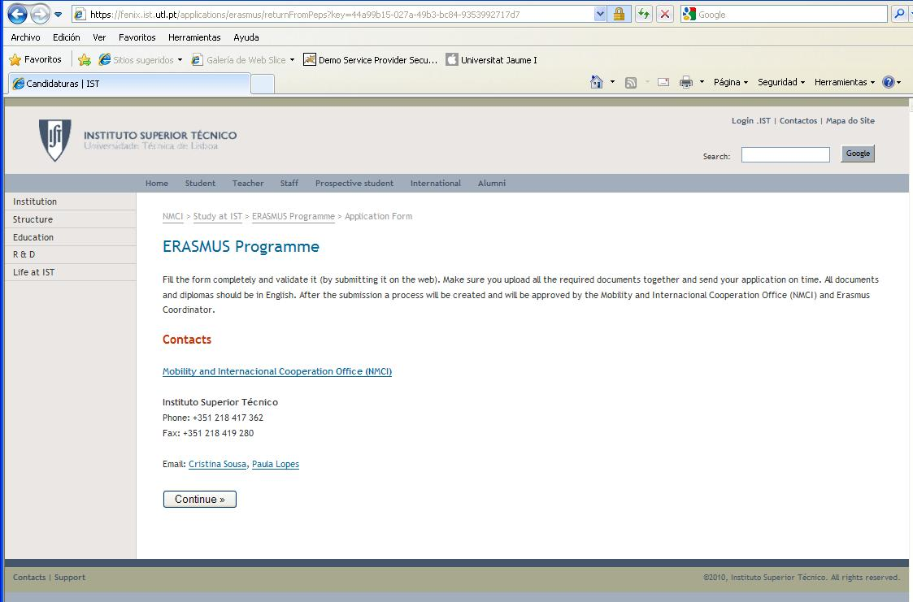

Slide 27
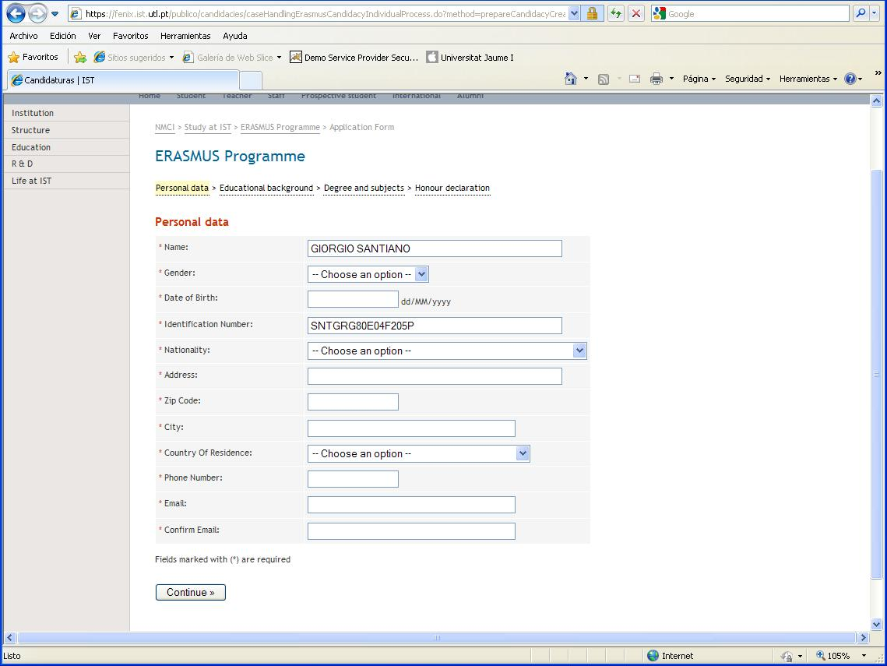

Slide 28
STORK Pilot 3 – eID Student Mobility
BENEFITS AND FUTURE
TRUST:
    full administrative guarantees
    Identity provided mainly by national authorities
    Error-free attributes
SUSTAINABILITY AND EXTENSION:
    Benchmark to analyze more complex data exchange among European Universities.
    Results can be extended to other aspects of public administration different from the academic environment.
    Tool for testing cross-border citizen oriented electronic services.

Slide 29



STORK – eID interoperability
THANK YOU FOR YOUR ATTENTION
info@eid-stork.eu

